Slide 1
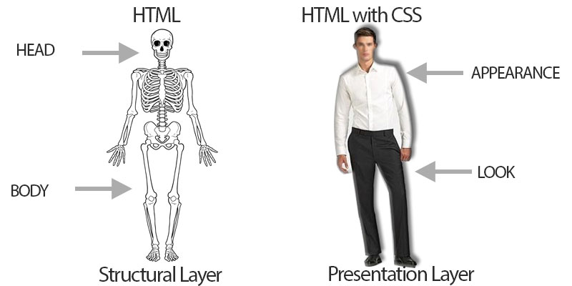
Intro to HTML/CSS
Samvit Das
Evan Kim

Slide 2
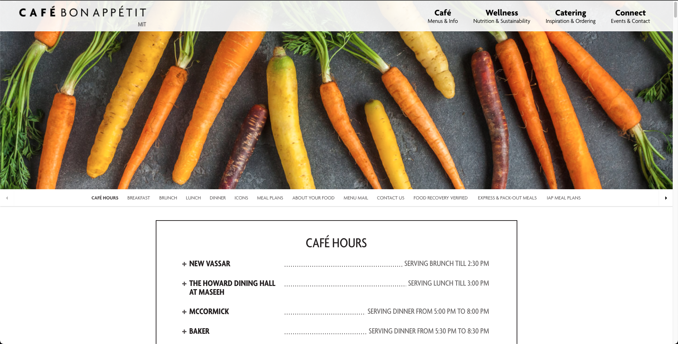
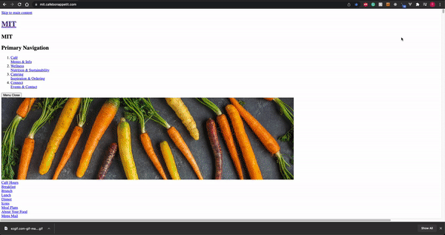
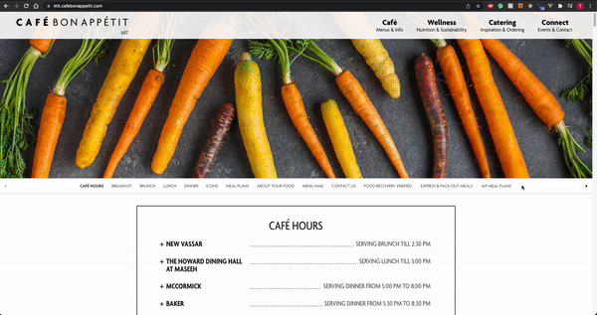
Why does this matter??
html
css
Notes:
Why HTML + CSS matters:
Fundamentally, we want our websites to have the most intuitive layout it can possibly have, with the prettiest style it could possibly have.
HTML and CSS are our core descriptions of these two things!

Slide 3
HTML
Hypertext Markup Language
The language your web browser uses to describe the content and structure of web pages
Notes:
Let’s start with HTML.
Hypertext Markup Language
HTML describes the structure of your webpage

Slide 4
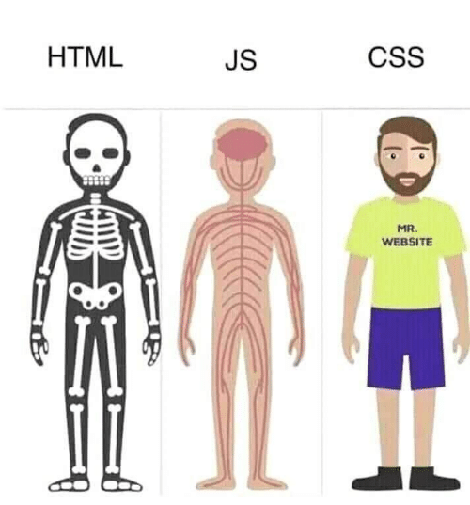
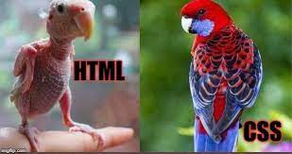
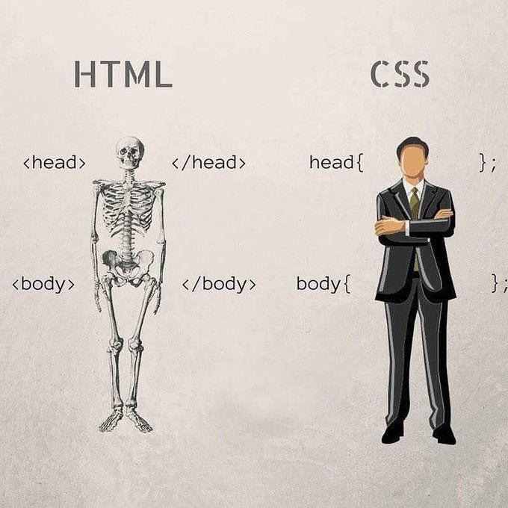
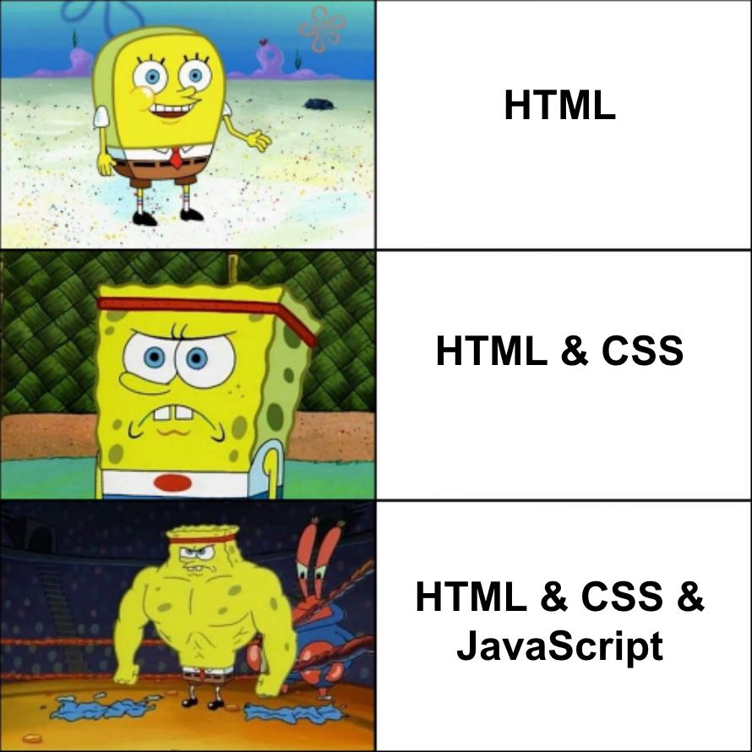
Notes:
High level: HTML - bones/structure. CSS - Skin/Styling

Slide 5
HTML = Nested Boxes
Main Idea:
Notes:
HTML is very very simple. Most of it can be summed up as just a bunch of boxes stacked together. For example, take this page from xkcd.

Slide 6
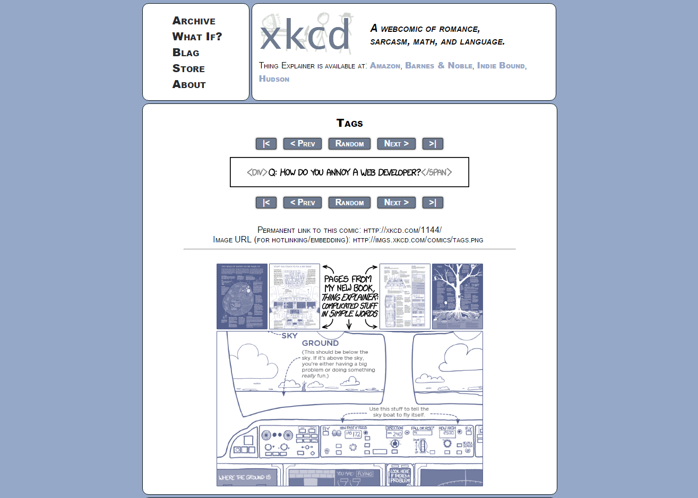
Notes:
As an example, let’s look at a nice webcomic website called xkcd…and here, we’ll really be able to see the power of HTML using nested boxes

Slide 13
Notes:
So this is all that HTML is…a bunch of boxes, nested inside of each other. let’s go to code

Slide 14
hello.html
<!DOCTYPE html> <html> <head> <title>Title!</title> </head> <body> <h1>Heading!</h1> <p>Paragraph!</p> </body> </html>

Slide 15

hello.html
<!DOCTYPE html> <html> <head> <title>Title!</title> </head> <body> <h1>Heading!</h1> <p>Paragraph!</p> </body> </html>

Slide 16
hello.html
<!DOCTYPE html> <html> <head> <title>Title!</title> </head> <body> <h1>Heading!</h1> <p>Paragraph!</p> </body> </html>
Notes:
this makes sure page uses latest html and not some random fallback version

Slide 17
hello.html
<!DOCTYPE html> <html> <head> <title>Title!</title> </head> <body> <h1>Heading!</h1> <p>Paragraph!</p> </body> </html>
Notes:
root

Slide 18
Elements are containers!
Opening tag
<html>
content goes here
</html>
Closing tag
Notes:
an html element is marked by opening and closing tags
each html element has an opening and closing tag that not only show where your nested containers are, but also what content exist within that container

Slide 19
hello.html
<!DOCTYPE html> <html> <head> <title>Title!</title> </head> <body> <h1>Heading!</h1> <p>Paragraph!</p> </body> </html>
Notes:
Looking back at our code, you can see there exist these containers to the code. Root html container…head container…body container…all of these containers are basically the nested boxes representation we were talking about before. And using these tags, we provide meaning to words. For instance the tag h1 here tells us that the word “Heading!” is a level 1 header - the “main” title - in our body content.

Slide 20

Notes:
If you want more details, you can look at the structure of HTML as the “DOM” (Document Object Model). It is how HTML is represented in memory and can be worth looking more into if you want more background.

Slide 21
Nesting
<a>
<b>
</a>
</b>
Notes:
no intersecting boxes. no quantum boxes. nada

Slide 22
Questions?

Slide 23
hello.html
<!DOCTYPE html> <html> <head> <title>Title!</title> </head> <body> <h1>Heading!</h1> <p>Paragraph!</p> </body> </html>
Notes:
once more looking at our webpage, let’s actually see what each of these elements do.

Slide 24
hello.html
<!DOCTYPE html> <html> <head> <title>Title!</title> </head> <body> <h1>Heading!</h1> <p>Paragraph!</p> </body> </html>
Notes:
we can see that the root contains head + body

Slide 25
hello.html
<!DOCTYPE html> <html> <head> <title>Title!</title> </head> <body> <h1>Heading!</h1> <p>Paragraph!</p> </body> </html>
Notes:
Title for document, scripts, styles, general information about the data on the page (“metadata”) (information for the browser and search engines)
https://developer.mozilla.org/en-US/docs/Glossary/Head

Slide 26
hello.html
<!DOCTYPE html> <html> <head> <title>Title!</title> </head> <body> <h1>Heading!</h1> <p>Paragraph!</p> </body> </html>

Slide 27
hello.html
<!DOCTYPE html> <html> <head> <title>Title!</title> </head> <body> <h1>Heading!</h1> <p>Paragraph!</p> </body> </html>
Notes:
if we go back to xkcd...

Slide 28
hello.html
<!DOCTYPE html> <html> <head> <title>Title!</title> </head> <body> <h1>Heading!</h1> <p>Paragraph!</p> </body> </html>

Slide 29
hello.html
<!DOCTYPE html> <html> <head> <title>Title!</title> </head> <body> <h1>Heading!</h1> <p>Paragraph!</p> </body> </html>

Slide 30
hello.html
<!DOCTYPE html> <html> <head> <title>Title!</title> </head> <body> <h1>Heading!</h1> <p>Paragraph!</p> </body> </html>
Notes:
Everything not in tags is text

Slide 31
Basic HTML Tags
<html>
<head>
<body>
<h1>, <h2>, <h3>, …
<p>
<div>
<span>
Root of HTML Document
Info about Document
Document Body
Header tags
Paragraph tag
Generic block section tag
Generic inline section tag
Notes:
Here are some basic HTML tags…you can take a moment to look at them but there are over a hundred of them and it’s better to look them up as you go along. We’ll go through these more in details but the first 3 are important as they are essential in basically all html documents and the last 2 are your most generic html tags that have no default styling or representation to them.

Slide 32
HTML Attributes
<tagname>
content goes here
</tagname>
Opening tag
Closing tag

Slide 33
HTML Attributes
attribute
value
<tagname abc="xyz">
content goes here
</tagname>
Opening tag
Closing tag
Notes:
HTML Attribute
- apply the attribute of anything under your element/tags. Modifies it.
- example of setting these HTML attributes is via links/images

Slide 34
Inserting Links
<a>
Link
Link to web.lab!
Notes:
a = “anchor”

Slide 35
HTML Attributes
attribute
value
Opening tag
<a href="link here">
content goes here
</a>
Closing tag
Notes:
a = “anchor”

Slide 36
Inserting Links
<a href="http://weblab.mit.edu">Link to web.lab!</a>
Link to web.lab!

Slide 37
Inserting Images
<img>
Image

Slide 38
Inserting Images
<img src="pusheen.gif"></img>
Notes:
self-closing tag

Slide 39
Inserting Images
<img src="pusheen.gif"></img>
Something’s weird here…
Should an image ever contain anything…?
Notes:
self-closing tag

Slide 40
Inserting Images
<img src="pusheen.gif"></img>
Notes:
self-closing tag

Slide 41
Inserting Images
<img src="pusheen.gif" />
For image, we use self-closing tag

Slide 42

Inserting Images
<img src="pusheen.gif" />
self-closing!

Slide 43
Inserting Images
hello.html
<img src="pusheen.gif" />
<!DOCTYPE html> <html> <head> <title>Title!</title> </head> <body> <img src="pusheen.gif"> </body> </html>
app/
hello.html
pusheen.gif
Notes:
Discuss folder structure

Slide 44
Inserting Images
hello.html
<img src="pusheen.gif" />
<!DOCTYPE html> <html> <head> <title>Title!</title> </head> <body> <img src="pusheen.gif"> </body> </html>
<img src="images/pusheen.gif"/>
app/
hello.html
images/
pusheen.gif

Slide 45

Inserting Images
What if the browser fails to display an image?
<img src="pusheen.gif"/>
where’s pusheen…
(confused user)

Slide 46

Inserting Images
What if the browser fails to display an image?
<img src="pusheen.gif" alt="pic of pusheen"/>
ok understandable
pic of pusheen
(understanding user)
(or bot)

Slide 47
Questions?

Slide 48
Lists
<ol>
<ul>
<li>
Ordered List (1, 2, 3…)
Unordered List (bullets)
List Item

Slide 49
hello.html
<!DOCTYPE html> <html> <head> <title>Title!</title> </head> <body>
<ul>
</ul> </body> </html>

Slide 50
hello.html
<!DOCTYPE html> <html> <head> <title>Title!</title> </head> <body>
<ul>
<li>Item 1</li>
</ul> </body> </html>
Item 1

Slide 51
hello.html
<!DOCTYPE html> <html> <head> <title>Title!</title> </head> <body>
<ul>
<li>Item 1</li>
<li>Item 2</li>
</ul> </body> </html>
Item 1
Item 2

Slide 52
div & span
your most generic elements!
<div> -
<span> -
groups a block section of a document
groups an inline section of a document

Slide 53
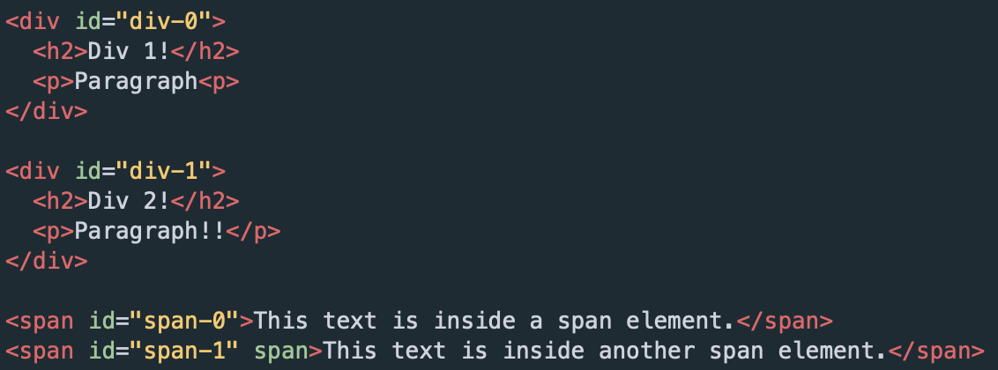
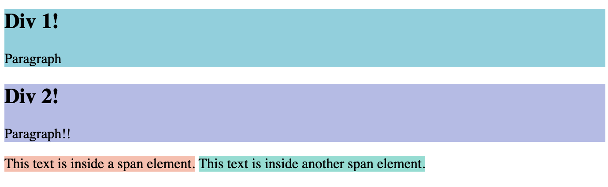
div & span

Slide 54
hello.html
<!DOCTYPE html> <html> <head> <title>Title!</title> </head> <body> <h1>Heading!</h1> <p>Paragraph!</p> </body> </html>
Notes:
if we wanted to take the contents of the body and put it into a box...

Slide 55
hello.html
<!DOCTYPE html> <html> <head> <title>Title!</title> </head> <body>
<div> <h1>Heading!</h1> <p>Paragraph!</p>
</div> </body> </html>
Notes:
div does nothing!!!

Slide 56
hello.html
<!DOCTYPE html> <html> <head> <title>Title!</title> </head> <body>
<div> <h1>Heading!</h1> <p>Paragraph!</p>
</div> </body> </html>
Notes:
but we have our box :)

Slide 57
so many tags...

Slide 58
<ul></ul>
<span></span>
so many tags...
<nav></nav>

Slide 59
General Advice
Online documentation (MDN Web Docs)
Always up to date!
Utilize Google to see what tag is best!
Notes:
https://developer.mozilla.org/en-US/docs/Web/HTML

Slide 60
Questions?

Slide 61
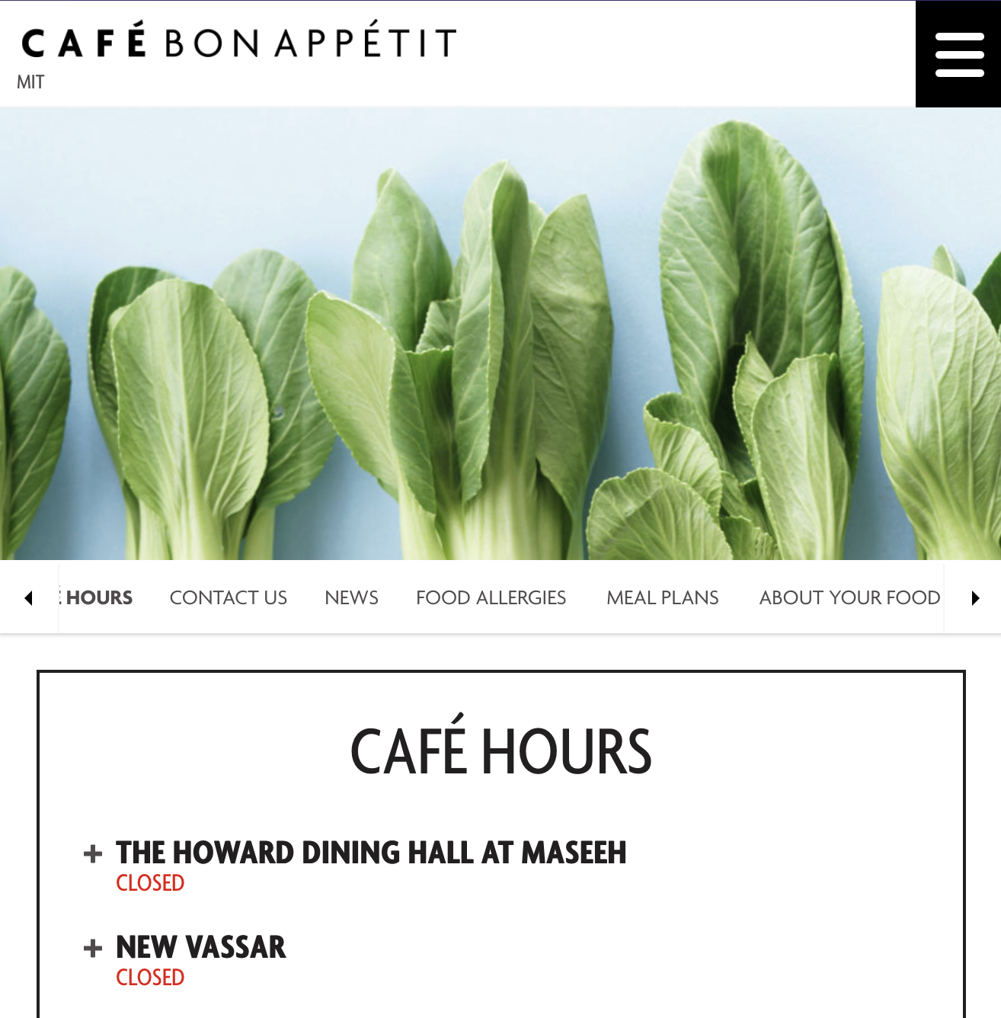
<div> is a default
<div>
<div>
<div>
<div>
<div>
<div>

Slide 62
Why not... “just use <div>”

Slide 63
Why not...
“just use <div>”
why could this be bad?

Slide 64
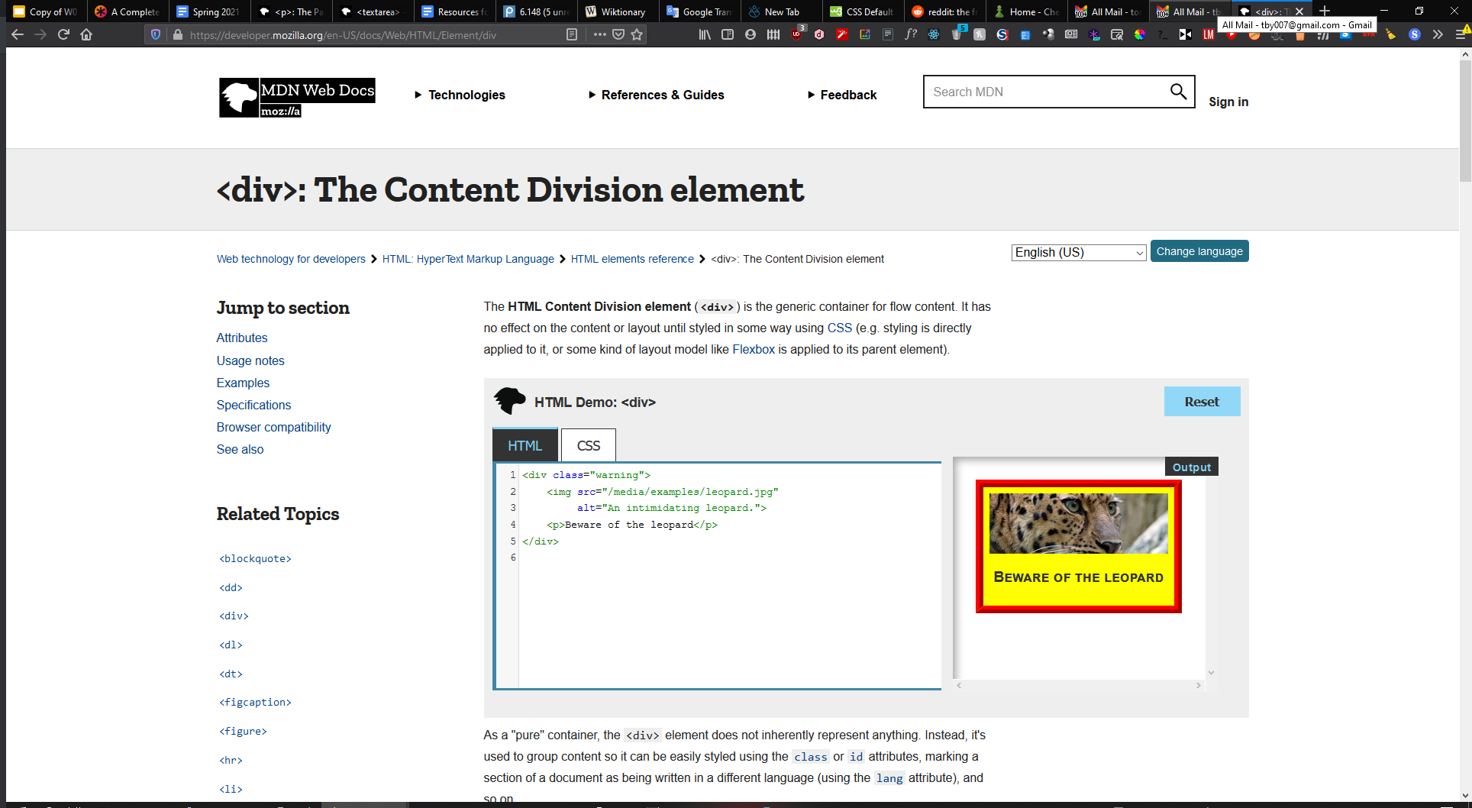
<div>

Slide 65
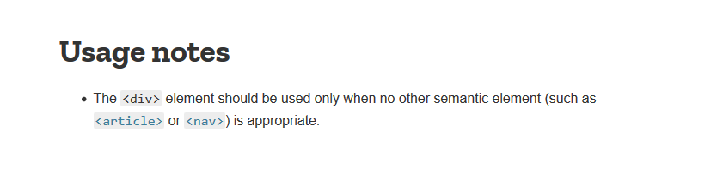
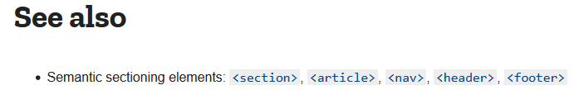
<div>
there might be better options...

Slide 66
Semantic Elements
very obvious what a <nav> is!
but not so much a <div>
[placeholders incoming]
Notes:
semantics were (news to me) pretty much introduced in HTML5, if you’re interested in backwards compatibility aspects, check here: https://developer.mozilla.org/en-US/docs/Web/Guide/HTML/Using_HTML_sections_and_outlines#Using_HTML5_elements_in_non-HTML5_browsers
also this section reused some content from sp20 6.s087’s HTML lecture. check that out here (currently broken on firefox): https://designftw.mit.edu/lectures/html/index.html

Slide 67


a brief aside... Why Semantics?
Screen readers
KB Navigation
(why can you tab through an order or sign up screen?)
Notes:
tabindex="0" also works for kb navigation (for presenting: for vid, skip to 7:00 after read out, for anyone reading this during/after the fact feel free to watch more of the vid!)
there are generally alternatives like the above to html elements such that you can make div have as much info as the prescribed tags, but that’s even more work!
don’t you love stock photos :P

Slide 68
a brief aside... Why Semantics?
Machine readable/friendly to web crawlers
(make your site more discoverable)
🤖
Human readable
(easier to maintain in the future)
👨‍👩‍👧‍👦
Notes:
https://en.wikipedia.org/wiki/Web_crawler

Slide 69
Don’t just use <div>.
Use MDN to find the element you need!
(it has its time and place though!)
Notes:
that’s not to say div is always bad! an example of a great use of div is when you purely want to nest something in a set of tags to apply specific CSS styling to something!

Slide 70
HTML
📦
Hypertext Markup Language
The language your web browser uses to describe the content and structure of web pages
Notes:
The wraps up our overview of HTML

Slide 71
Questions?

Slide 72
CSS

Slide 73
CSS
Cascading Style Sheets
The rules that tell your web browser how stuff looks
Notes:
“cascading”

Slide 74
CSS = A list of descriptions
used for markup languages, such as HTML

Slide 75


Slide 76


Slide 77
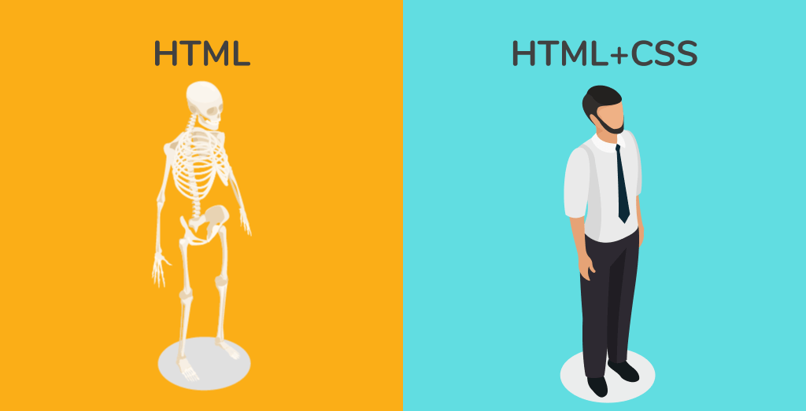
CSS = A list of descriptions
aka making things look pretty

Slide 78
CSS ruleset (rule)
selector
To select which html tag you want to style
property
value
div {
color: red;
font-family: Arial;
font-size: 24pt;
}
Notes:
this is an example “CSS rule”
https://developer.mozilla.org/en-US/docs/Web/CSS/CSS_Selectors

Slide 79
hello.html
<!DOCTYPE html> <html> <head> <title>Title!</title> </head> <body>
<h1>Heading!</h1> <div>Paragraph!</div> </body> </html>
Heading
Paragraph!
Notes:
using div instead of p for the sake of example

Slide 80
hello.html
Heading
<h1>Heading!</h1> <div>Paragraph!</div>
Paragraph!

Slide 81
hello.html
Heading
<h1>Heading!</h1> <div>Paragraph!</div>
<div>Info</div>
Paragraph!
Info

Slide 82
hello.html
<h1>Heading!</h1> <div>Paragraph!</div>
<div>Info</div>
Heading
Paragraph!
style.css
Info
div {
color: red;
font-family: Arial;
font-size: 24pt;
}
Notes:
stylesheets: your own personal makeup artist

Slide 83
hello.html
<h1>Heading!</h1> <div>Paragraph!</div>
<div class="info">Info</div>
Heading
Paragraph!
style.css
Info
div {
color: red;
font-family: Arial;
font-size: 24pt;
}

Slide 84
hello.html
<h1>Heading!</h1> <div>Paragraph!</div>
<div class="info">Info</div>
Heading
Paragraph!
style.css
Info
.info {
color: red;
font-family: Arial;
font-size: 24pt;
}
Notes:
Target ONLY elements with the class “info” to be red, Arial, etc.

Slide 85
hello.html
<h1>Heading!</h1> <div>Paragraph!</div>
<div id="unique">Info</div>
Heading
Paragraph!
style.css
Info
#unique {
color: red;
font-family: Arial;
font-size: 24pt;
}
Notes:
Target ONLY element with the id “unique” to be red, Arial, etc.

Slide 86
ID vs Class
ID
Class

Slide 87
ID vs Class
ID
An element can have only one ID
Class
An element can have multiple classes

Slide 88
ID vs Class
ID
An element can have only one ID
<div id="element-id">
Class
An element can have multiple classes
<div class="class1 class2 class3">
Ex:
<div class="list-item container">
Notes:
You can assign this div to have one id but can assign multiple classes to it. Perhaps one class is to specify sizing, another color, etc. you can apply those custom classes to one div, but you can only have one id assigned to a div.

Slide 89
ID vs Class
ID
An element can have only one ID
IDs must be unique in any given HTML document
Class
An element can have multiple classes
Can use the same class on multiple elements
IDs must be unique in a document while you can use the same class on multiple elements. So say that you want to make a lot of different elements in your page have the font color red. If you were to use Id, you’d have to make a new id for every single element rather than just reuse the same class across multiple elements. So there is a 1 to 1 relationship between an id and an html element. You can’t have multiple ids per element and you can’t have multiple elements per id
Notes:
IDs must be unique in a document while you can use the same class on multiple elements. So say that you want to make a lot of different elements in your page have the font color red. If you were to use Id, you’d have to make a new id for every single element rather than just reuse the same class across multiple elements. So there is a 1 to 1 relationship between an id and an html element. You can’t have multiple ids per element and you can’t have multiple elements per id

Slide 90
ID vs Class
ID
An element can have only one ID
IDs must be unique in any given HTML document
Class
An element can have multiple classes
Can use the same class on multiple elements
(They can be reused!)
Notes:
IDs must be unique in a document while you can use the same class on multiple elements. So say that you want to make a lot of different elements in your page have the font color red. If you were to use Id, you’d have to make a new id for every single element rather than just reuse the same class across multiple elements. So there is a 1 to 1 relationship between an id and an html element. You can’t have multiple ids per element and you can’t have multiple elements per id

Slide 91
ID vs Class
ID
An element can have only one ID
IDs must be unique in any given HTML document
#id {
…
}
Class
An element can have multiple classes
Can use the same class on multiple elements
.classname {
…
}

Slide 92
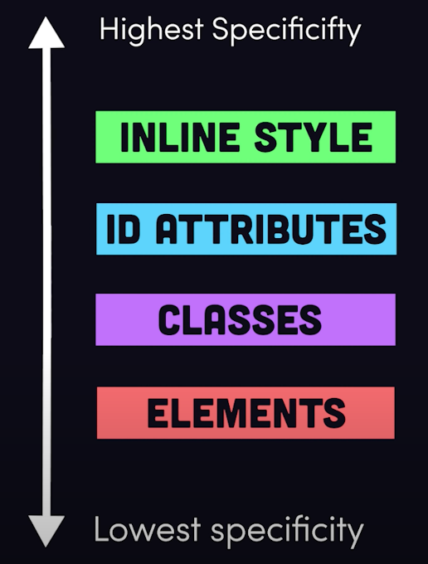
CSS Hierarchy
(ignore)
#unique {...}
.info {...}
div {...}
read more about specificity of selectors here
Notes:
This slide is provided as a more advanced guide into the CSS.
Important but tricky to understand is the CSS hierarchy, specificity, and inheritance. Rules that are more specific will override the rules that are less specific as well as the rules of their parents. There also exist certain rules that inherit the rules of their parents but these are simply cases that you have to look up as you develop your website.
Happy to answer any questions but the best thing to do is to look up specific cases as you come across them and don’t worry about this slide if none of what I wrote made sense :)

Slide 93
hello.html
<h1>Heading!</h1> <div>Paragraph!</div>
<div class="info">Info</div>
Heading
Paragraph!
style.css
Info
.info {
color: red;
}
div {
color: blue;
font-family: Arial;
}
Notes:
class takes precedence

Slide 94

Only use classes for CSS styling!

Slide 95
Questions?

Slide 96
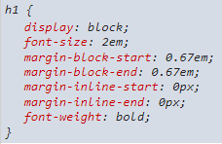
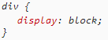
Important Concept!
Tags such as <h1> have some default styling while <div> and <span> do not.

Slide 97
Important Concept!
Tags such as <h1> have some default styling while <div> and <span> do not.
Any custom applied CSS rules will overwrite it!

Slide 98
Important Concept!
Tags such as <h1> and <p> are basically the same as <div> except they have some default styling.
NO THIS IS BAD
So, you can build a webpage using <p> and <h1>, and then override the styling for those elements by creating CSS rules for p and h1…
… or you could build your webpage (almost) entirely out of divs, create CSS rules for various classes, and apply classes to divs on the webpage!
(often a combination of both)
Notes:
header tags give a little more info to screen readers; while p tags don’t do much more than div tags; and divs are more generalizable for styling

Slide 99
Combining HTML and CSS

Slide 100
hello.html
<!DOCTYPE html> <html> <head> <title>Title!</title> </head> <body> <h1>Heading!</h1> <p>Paragraph!</p> </body> </html>

Slide 101
hello.html
<!DOCTYPE html> <html> <head> <title>Title!</title> <link rel="stylesheet" href="style.css" /> </head> <body> <h1>Heading!</h1> <p>Paragraph!</p> </body> </html>
Notes:
There are other ways but they’re not good
“rel” stands for relationship if you’re curious
also note that <link> is different from <a> and should not be used to create a hyperlink!

Slide 102
hello.html
<!DOCTYPE html> <html> <head> <title>Title!</title> <link rel="stylesheet" href="style.css" /> </head> <body> <h1 class="my-class">Heading!</h1> <p>Paragraph!</p> </body> </html>
Notes:
There are other ways but they’re not good
“rel” stands for relationship if you’re curious
also note that <link> is different from <a> and should not be used to create a hyperlink!

Slide 103
HTML/CSS in your browser…

Slide 104
In Conclusion:
HTML = nested boxes
CSS = a list of descriptions
A description in the CSS
affects a box in the HTML

Slide 105
Questions?

Slide 106
Feedback Time!
weblab.is/feedback

Slide 107

Lunch Break!
until 1:00
Do Not Eat Food in the Lecture Hall or MIT will get mad at us!
We’ll be getting started on Workshop 0 after lunch, so please try to get your terminal and Visual Studio Code setup!
HERE (or check Piazza)
Need help? Ask a staff member :)

